Slide 1
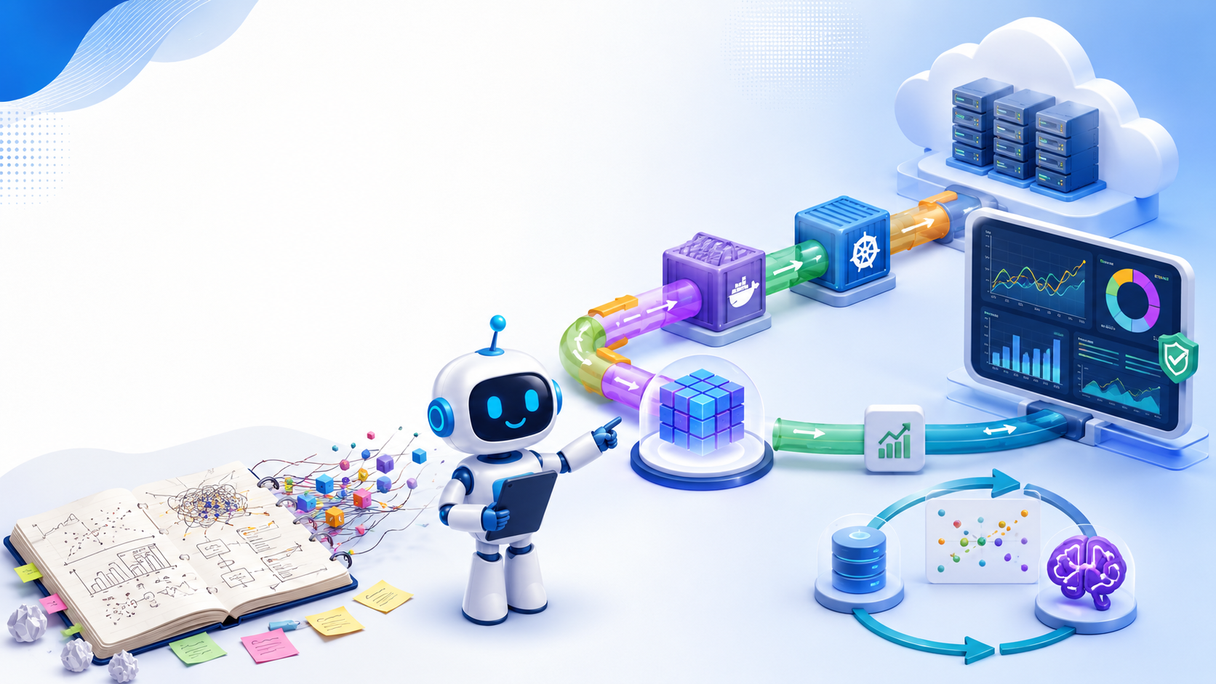
01
Introduction to
MLOps
Docker, Kubernetes, MLflow, Drift, and Retraining
Data Science – Spring 2026
Prepared by: Mostafa Kermaninia, Mohammad Amanlou
University of Tehran · May 2026

Slide 2
MLOps Story
02
What you will learn today
• Understand the difference between a model that works in a notebook and one that is ready for production
• Recognize why tools like Docker, Kubernetes, and MLflow enter the machine learning workflow
• Draw a simple MLOps pipeline
• Explain the concept of drift and why retraining is necessary
• Discuss the risks of deploying a new model
Big idea: ML does not end at “accuracy on the test set.”

Slide 3
MLOps Story
03
By the end of this session you should be able to:
• List at least five problems that occur when a model stays inside a Jupyter notebook
• Describe each MLOps stage: data, training, tracking, packaging, deployment, monitoring, and retraining
• Write a simple Dockerfile for a scikit-learn model API
• Use MLflow to log parameters, metrics, and artifacts
• Explain Data Drift and Concept Drift with a real-world example
• Propose a retraining strategy based on monitoring signals

Slide 4
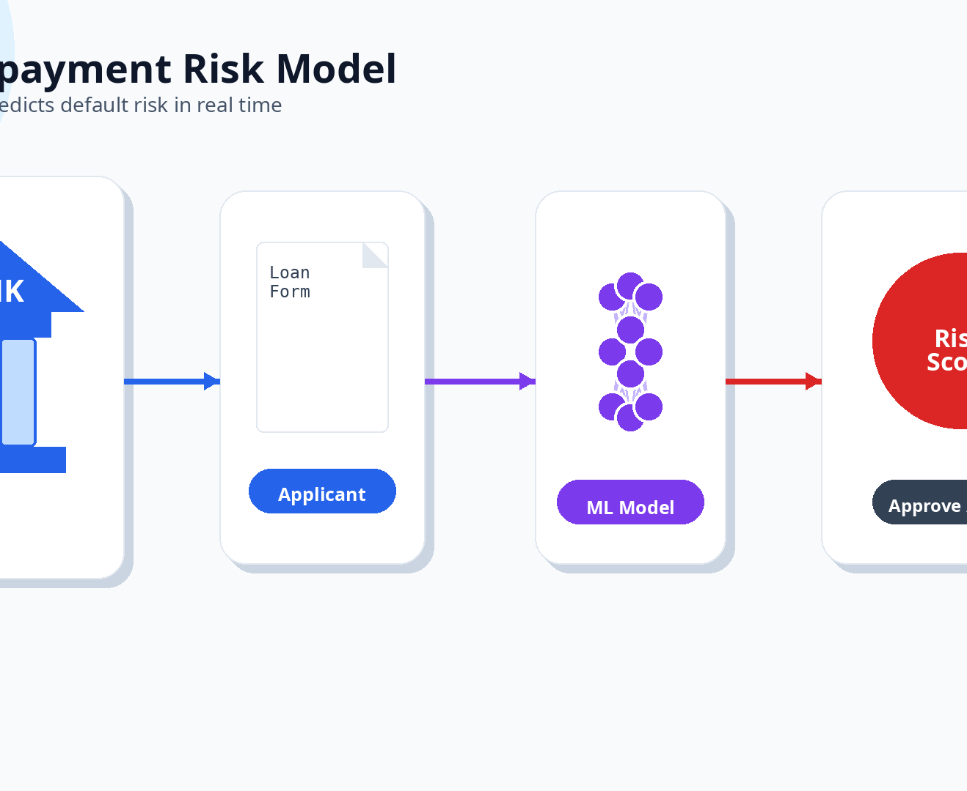
MLOps Story
04
Loan Repayment Risk Model
• A bank has built a model that predicts whether a customer will repay a loan or default
• Inside the Jupyter notebook, the model shows 92% accuracy on the test set
• The bank now wants to integrate the model into its real-time loan approval system
• This is the journey we will follow throughout the entire class
Story anchor: one loan-risk model, many production problems.

Slide 5
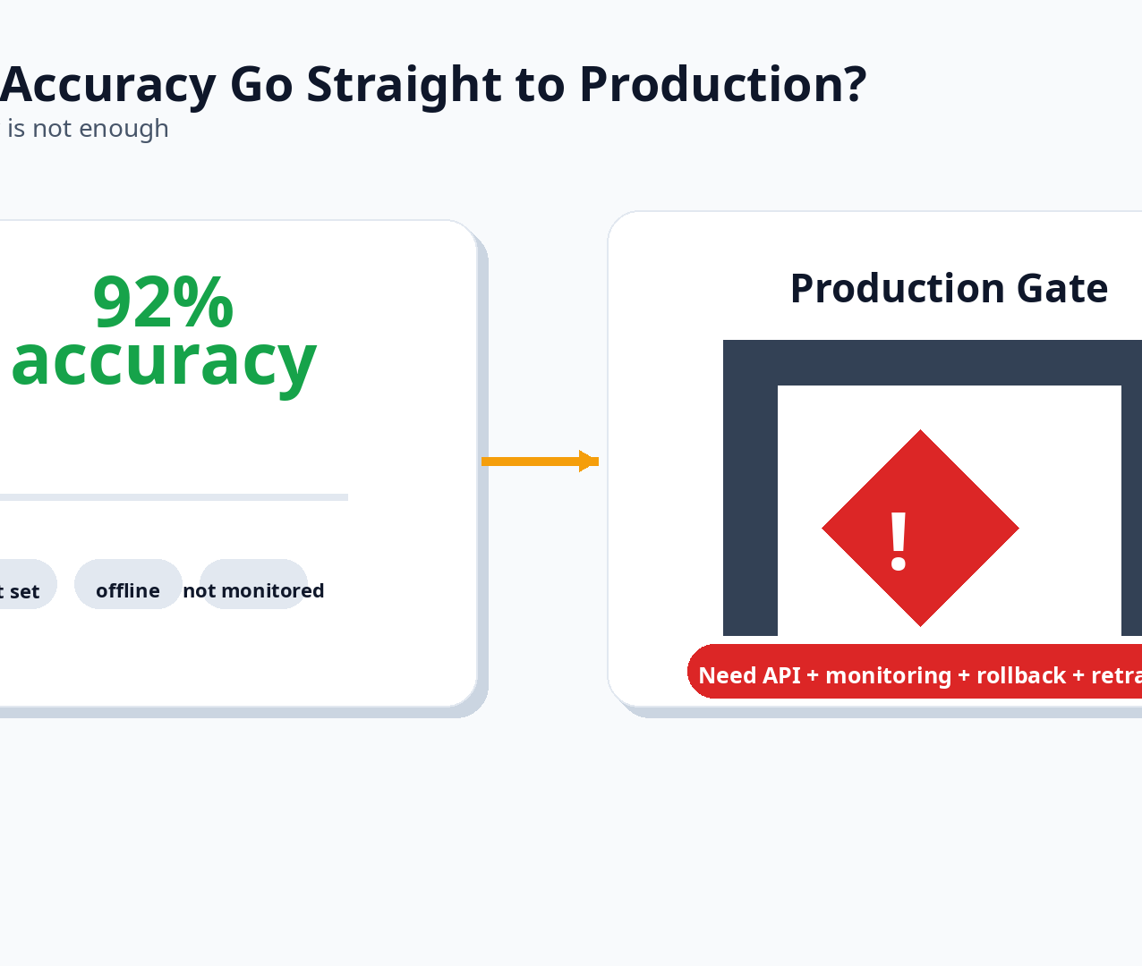
MLOps Story
05
Ask yourself:
92% accuracy ≠ ready for production
• Can we immediately deploy it and approve real loan applications? The correct answer is NO.
• We need packaging, a serving API, monitoring, versioning, rollback, and retraining.
• A high test score does not guarantee the model will work next month with new customers.

Slide 6
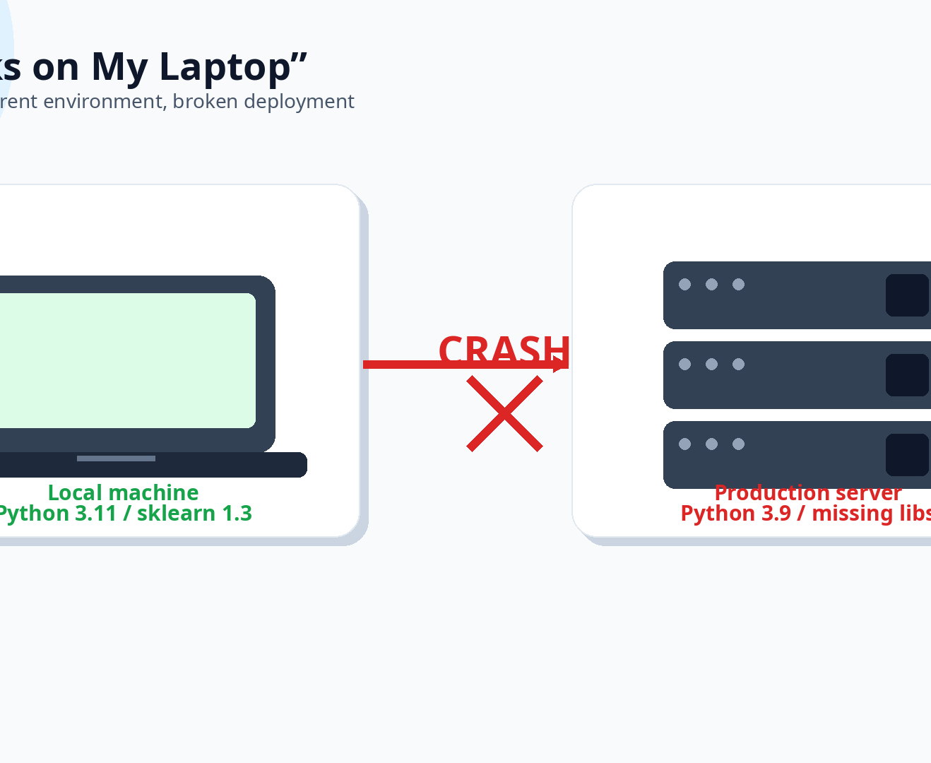
MLOps Story
06
Problem: “It works on my laptop.”
• The model runs on the professor’s machine but crashes on the production server.
• Reasons:
– Different Python version (3.11 vs 3.9)
– Different library versions (scikit-learn 1.3 vs 1.0)
– Missing system packages
– Different operating system paths
• The model is environment-dependent; it is not portable.
Classic production horror story: same code, different environment, boom.

Slide 7
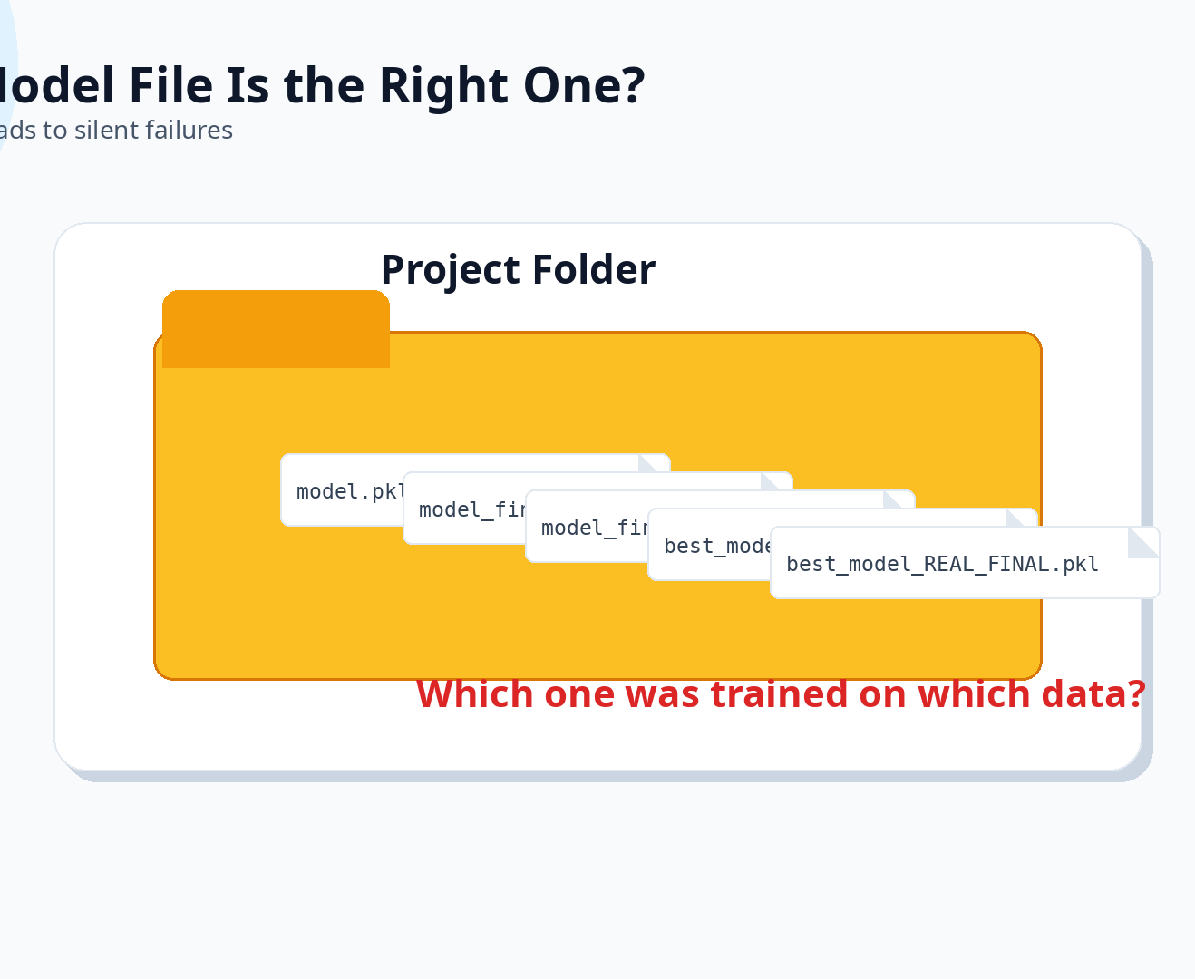
MLOps Story
07
Problem: Which model file is the right one?
• You end up with files like: model.pkl, model_final.pkl, model_final2.pkl, best_model.pkl, best_model_REAL_FINAL.pkl
• Nobody knows which one was trained on which data, with which parameters, and what metrics it achieved.
• Deploying the wrong version can cause silent failures.
If your file name says REAL_FINAL, it is probably not final 🙃

Slide 8
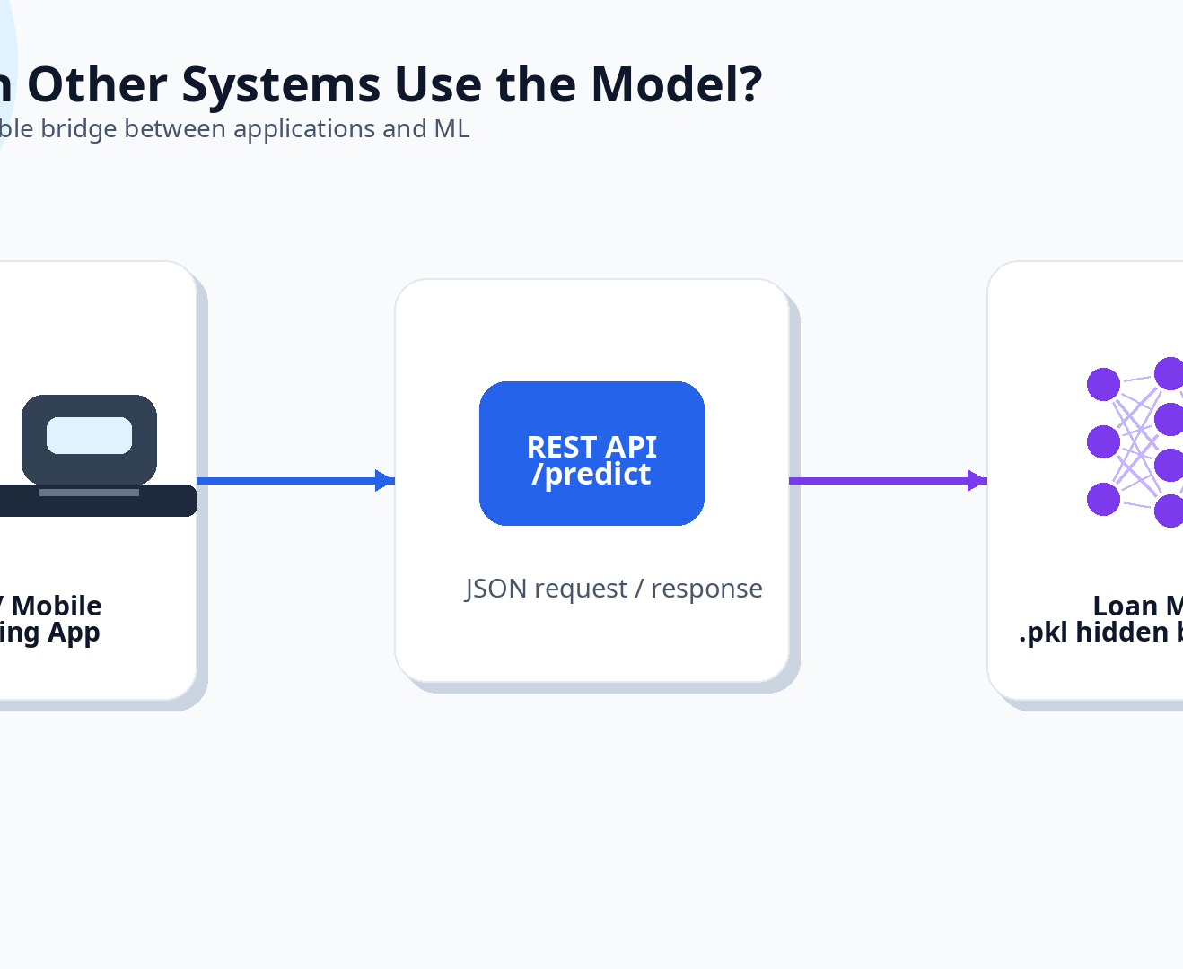
MLOps Story
08
Problem: How can other systems use the model?
• The banking application cannot load a .pkl file directly.
• There is no standard way to send customer information and receive a risk prediction.
• Without an API, the model is an isolated island.
• We need a clear input schema, a clear output schema, and a network endpoint.

Slide 9
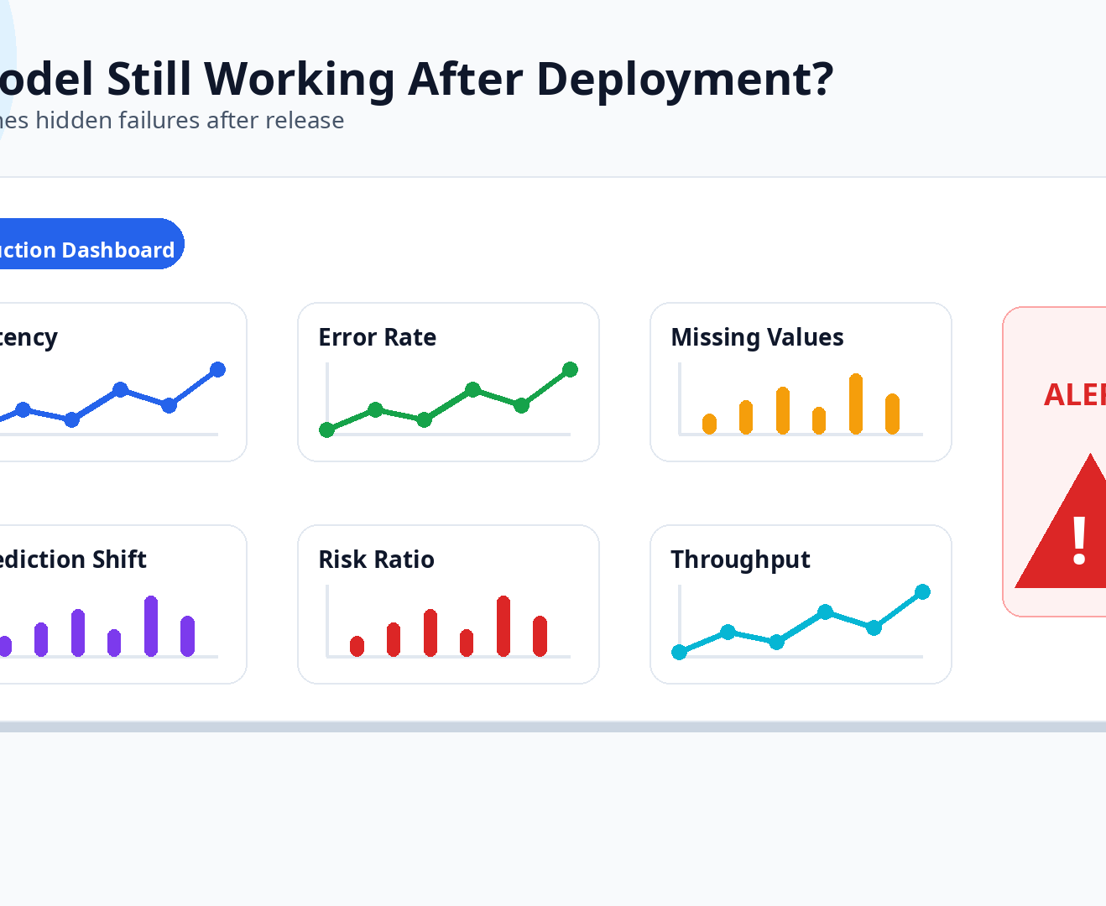
MLOps Story
09
Problem: Is the model still working after deployment?
• The model was deployed three months ago. Nobody checks whether predictions are still correct.
• Possible hidden issues:
– High-risk scores for almost everyone
– Prediction latency increased
– Input features arrive with missing values
• An unmonitored model is a black box that can silently harm the business.

Slide 10
MLOps Story
10
Problem: The model is using outdated data.
• Customer behavior changed after an economic shift, but the model was trained on data from two years ago.
• Nobody knows when to retrain, how to retrain, or who is responsible.
• Without a retraining plan, performance gradually decays until the model becomes useless.
The world changes. Your model will not magically update itself.

Slide 11
MLOps Story
11
Notebook (Lab) vs. Production
The same model lives in two very different worlds.
Aspect | Notebook / Lab | Production
Focus | Accuracy, metrics | Quality, stability, security, latency
User | One person (data scientist) | Many systems, real users
Data | Static, clean, prepared | Live, incomplete, changing, sometimes erroneous
Error cost | Low (just a number) | High (financial, legal, reputational)
Execution | Manual, cell by cell | Automated, scheduled, monitored

Slide 12
MLOps Story
12
Important Warning
Training accuracy is not a production guarantee
• The production environment changes constantly.
• Data distributions shift.
• Assumptions that were true during training may become false later.
• The model must be continuously observed, tested, and updated.

Slide 13
MLOps Story
13
Definition of MLOps
• MLOps manages the full lifecycle of a machine learning model — from data and training to deployment, monitoring, and retraining.
• It combines:
– Software engineering best practices
– DevOps principles: automation, CI/CD, reliability
– Machine learning specifics: data, experiments, model drift
• Goal: make models repeatable, reliable, monitorable, and updatable in production.

Slide 14
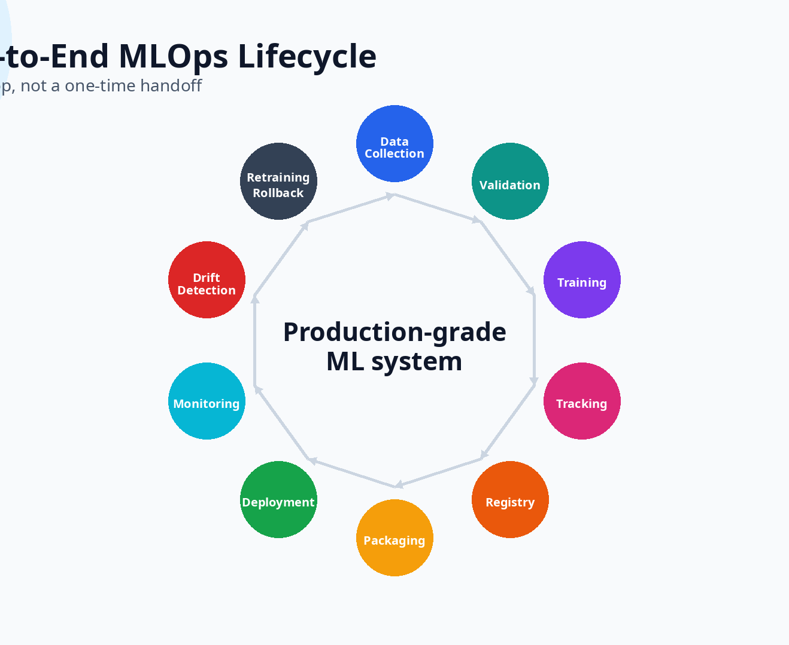
MLOps Story
14
The End-to-End MLOps Lifecycle
• A production-grade ML system follows a continuous cycle, not a single linear step.
• Data Collection → Data Validation → Training → Experiment Tracking → Model Registry → Packaging → Deployment → Monitoring → Drift Detection → Retraining / Rollback
• This cycle repeats throughout the model’s life.
• Skipping any stage creates risk in production.

Slide 15
MLOps Story
15
Three Foundational Concepts
The first three building blocks of production ML.
🧪 Experiment Tracking
Record parameters, metrics, code version, data version, and artifacts.
Tool example: MLflow Tracking.
Without it: you cannot reproduce or compare experiments.
🏷️ Model Registry
A central place to store, version, and manage model stages.
Stages: Development → Staging → Production → Archived.
Tool example: MLflow Model Registry.
📦 Packaging
Bundle the model, dependencies, and serving code into a deployable unit.
Tool example: Docker.
Without packaging: works-on-my-machine syndrome.

Slide 16
MLOps Story
16
More Foundational Concepts
Serving, orchestration, and monitoring complete the story.
🌐 Model Serving
Expose the model as a service: API or batch job.
Tool examples: FastAPI, Flask.
Requires a clear input/output schema.
☸️ Orchestration
Manage multiple containers across many servers.
Tool example: Kubernetes.
Handles self-healing, scaling, and rolling updates.
📊 Monitoring
Observe system health, data quality, model performance, and business impact.
Tool examples: Prometheus, Evidently, Grafana.
Two types: service health and model behavior.

Slide 17
MLOps Story
17
Who Does What in an MLOps Team?
Production ML is a team sport.
🔬 Data Scientist
Develops the model, designs experiments, evaluates baseline performance.
🛠️ ML Engineer
Converts the model into a production-ready system, builds pipelines, writes APIs, sets up tracking.
⚙️ DevOps / Platform Engineer
Provides infrastructure for deployment, monitoring, and scaling. Manages clusters and networks.
🏦 Domain Expert
Interprets data, errors, and real-world changes. Ensures decisions align with business reality.
In smaller teams, one person may wear several hats. In larger ones, these roles are specialized.

Slide 18
MLOps Story
18
Exercise (2 minutes)
• For an email spam detection model, list the MLOps lifecycle components.
• Where does data come from?
• How do you train and track experiments?
• What does packaging look like?
• How is it deployed?
• What do you monitor?
• When do you retrain?
We will share a few answers after a short discussion.

Slide 19
From Notebook to Code
19
Why You Cannot Deploy a Notebook Directly
• Cell execution order is not guaranteed — hidden state can break reproducibility.
• Hard to test individual functions.
• Dependencies are implicit: which library version?
• Mixing exploration, training, and serving code in one file leads to chaos.
• Version control is messy with large notebook outputs.
• Solution: extract the code into a structured, modular project.

Slide 20
From Notebook to Code
20
A Clean ML Project Layout
Separate training code from prediction code.
ml_project/
├── data/
├── models/
│ └── loan_model.pkl
├── src/
│ ├── train.py
│ └── predict.py
├── tests/
├── requirements.txt
└── README.md
• Keep configuration in a single place.
• Include tests and a README.
• Make the project easy for another person to run.
Rule of thumb: production code should survive outside your notebook.

Slide 21
From Notebook to Code
21
Production-Ready Code Is Modular
Training and inference should not be glued together.
# src/train.py
train_model(config)
evaluate_model(model)
save_model(model, path)
# src/predict.py
def predict(input_row):
"""One function, no hidden state."""
return model.predict(input_row)
• src/train.py contains training logic, parameterization, and model saving.
• src/predict.py provides a clean function for inference.
• One function, no hidden state, testable.

Slide 22
From Notebook to Code
22
Before You Deploy, Verify:
• ✅ Training code and inference code are separated
• ✅ Python version and all libraries are explicitly declared (requirements.txt)
• ✅ The saved model is stored with metadata: timestamp, parameters
• ✅ Input and output schemas are documented: fields and types
• ✅ A simple test for the predict function exists
• ✅ The README explains how to run the code and train a new model
Anything only existing in the model builder’s head must become a file, code, documentation, or metadata.

Slide 23
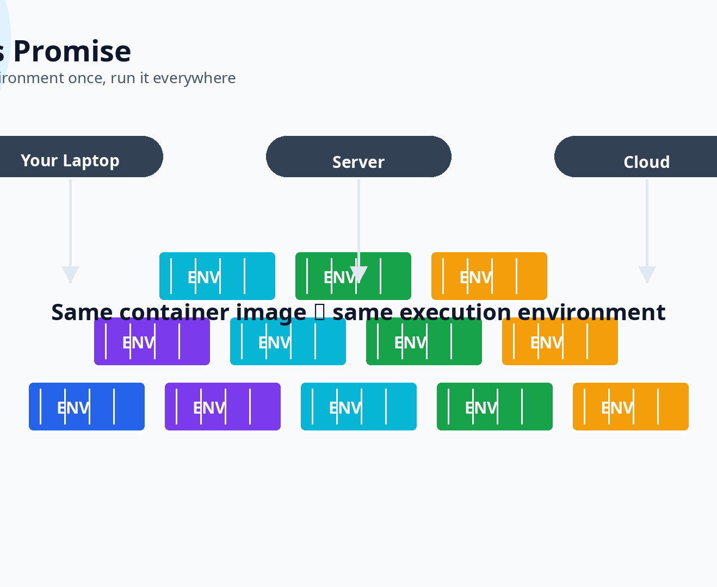
Docker
23
The Same Old Problem
• “It runs on my laptop, but crashes on the server.”
• Root cause: different OS, Python versions, and missing system libraries.
• Copying files and installing libraries by hand is error-prone and not reproducible.
• Docker’s promise: package application, dependencies, configuration, and files into a portable container.
• The container runs the same way everywhere: laptop, server, cloud.

Slide 24
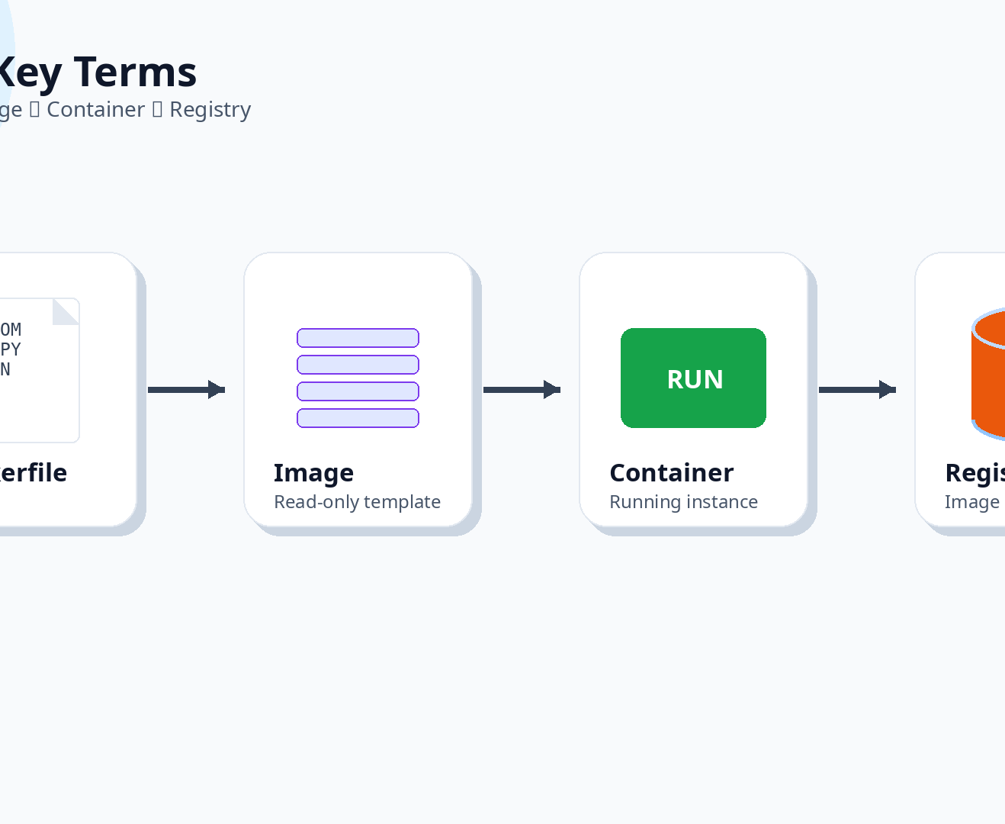
Docker
24
Key Terms
• Dockerfile: instructions for building the environment — like a recipe.
• Image: the built result from a Dockerfile; a read-only template.
• Container: a running instance of an image. You can start, stop, and delete it.
• Registry: a place to store and share images, such as Docker Hub or a private registry.

Slide 25
Docker
25
Dockerfile Example
A tiny recipe for a reproducible environment.
FROM python:3.11-slim
WORKDIR /app
COPY requirements.txt .
RUN pip install --no-cache-dir -r requirements.txt
COPY . .
CMD ["python", "train.py"]
• Start from a known Python base image.
• Install exact dependencies from requirements.txt.
• Copy project files into the container.
• Define the default command.

Slide 26
Docker
26
Dockerfile Instructions
What each line means.
Instruction | Meaning
FROM python:3.11-slim | Start from a light Python base image
WORKDIR /app | Set the working directory inside the container
COPY requirements.txt . | Copy the dependency file
RUN pip install ... | Install required libraries
COPY . . | Copy the rest of the project code
CMD ... | Default command to run when the container starts

Slide 27
Docker
27
Basic Docker CLI Commands
Build, tag, and run the image.
# Build an image and tag it
docker build -t loan-model-api:v1 .
# Run the API and map ports
docker run -p 8000:8000 loan-model-api:v1
• -t tags the image with a name and version.
• -p maps a port on your host to the container’s port.
• Always use meaningful tags to version your images.

Slide 28
Docker
28
Important Clarification
• Docker does not make your model more accurate, faster, or smarter.
• Docker’s job is operational:
• It makes the execution environment repeatable.
• It makes the application portable.
• It helps teams avoid the “works on my machine” problem.
• Think of Docker as a standard shipping container: it protects the cargo and makes transport uniform, but it does not improve the cargo itself.
Docker protects the environment, not the model’s intelligence.

Slide 29
Docker
29
Exercise: What Must Be Documented?
• “My model works on my system. On my friend’s computer it fails.” What information should be fixed and documented?
• Expected answers: Python version, exact library versions, model file, file paths or relative paths, environment variables, and the command to run the application.
• Docker encodes all of this in a Dockerfile and ensures consistency.

Slide 30
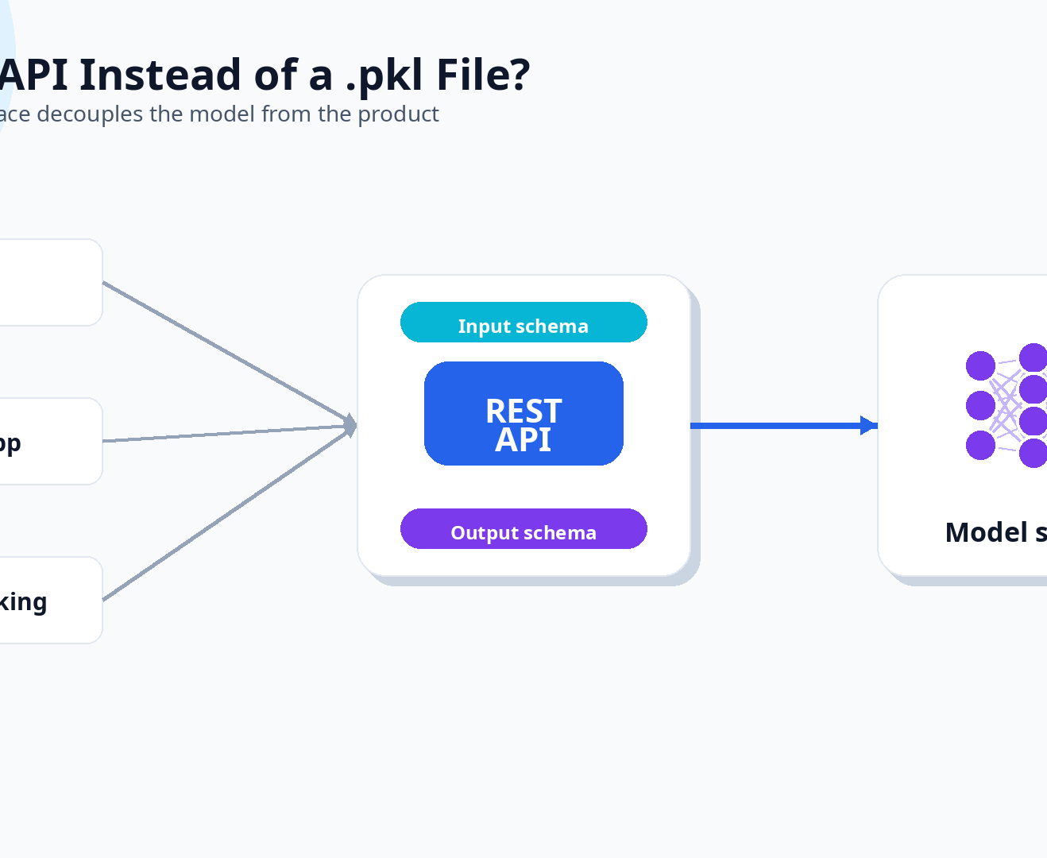
Serving with APIs
30
Why Not Just Load the .pkl File in the Application?
• The loan approval system could be a web app, mobile backend, or core banking system — none of them understand Python pickle files.
• An API provides a standard communication path that any client can call over the network.
• Benefits: decouples the model, defines inputs/outputs, enables latency/error monitoring, and allows upgrade or rollback.
• Common protocols: REST (JSON) or gRPC.

Slide 31
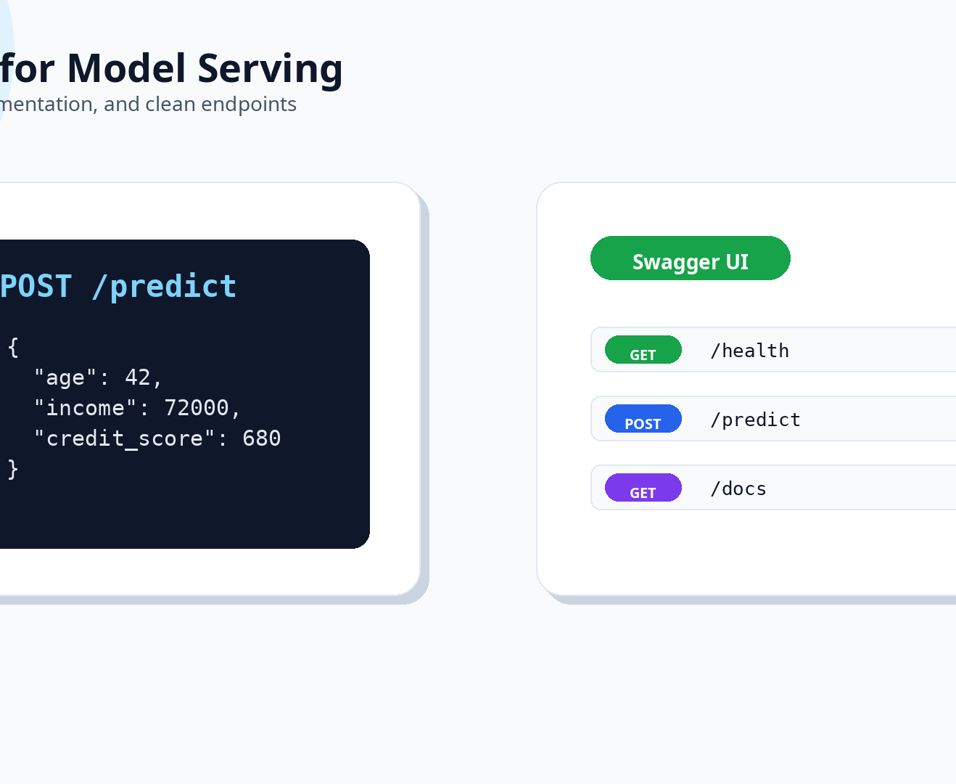
Serving with APIs
31
FastAPI – A Modern Python Web Framework for APIs
• Built on Python type hints — automatic request validation.
• Automatic interactive documentation: Swagger UI.
• High performance with async support.
• Perfect for wrapping a machine learning model: input schema, /health endpoint, /predict endpoint, lightweight and container-friendly.

Slide 32
Serving with APIs
32
API Code (Part 1)
Imports, app initialization, and input schema.
from fastapi import FastAPI
from pydantic import BaseModel
import joblib
app = FastAPI()
model = joblib.load("models/loan_model.pkl")
class LoanRequest(BaseModel):
age: int
income: float
credit_score: int
• FastAPI() creates the application.
• joblib.load() loads the trained model once at startup, not on every request.
• LoanRequest defines the exact fields and types the API expects.
• Requests with missing or wrong types are automatically rejected.

Slide 33
Serving with APIs
33
API Code (Part 2)
Endpoints for health checking and prediction.
@app.get("/health")
def health():
return {"status": "ok"}
@app.post("/predict")
def predict(req: LoanRequest):
x = [[req.age, req.income, req.credit_score]]
prob = model.predict_proba(x)[0, 1]
return {
"label": int(prob >= 0.5),
"probability": float(prob)
}
• /health tells infrastructure that the service is alive.
• /predict receives a JSON request and returns a prediction.
• Returning probability keeps the output useful for business decisions and monitoring.

Slide 34
Serving with APIs
34
Example Request and Response
A standard JSON conversation with the model API.
POST /predict
{
"age": 42,
"income": 72000,
"credit_score": 680
}
200 OK
{
"label": 0,
"probability": 0.23
}
JSON makes the model usable by web apps, mobile apps, and banking systems.

Slide 35
Serving with APIs
35
Improved Dockerfile for Serving the API
Lighter image, explicit port, and uvicorn server.
FROM python:3.11-slim
WORKDIR /app
COPY requirements.txt .
RUN pip install --no-cache-dir -r requirements.txt
COPY app/ app/
COPY models/ models/
EXPOSE 8000
CMD ["uvicorn", "app.main:app", "--host", "0.0.0.0", "--port", "8000"]
• Copy only app/ and models/ folders, not the whole project.
• EXPOSE 8000 documents the container port.
• uvicorn is the ASGI server that runs FastAPI.

Slide 36
Serving with APIs
36
The /health Endpoint
• Returns {"status": "ok"} when the service is alive and ready.
• Used by:
– Kubernetes liveness and readiness probes
– Load balancers to check healthy instances
– Monitoring tools to alert if service is down
• A real health check may also verify model loading and database connections.
• Rule: every production service should have a health endpoint.
Tiny endpoint, huge operational value.

Slide 37
Serving with APIs
37
Question for Students
• Should the API return only the final label (0 or 1) or also the probability?
• Correct approach: return both.
• The business may use a threshold different from 0.5.
• You might want to rank applicants, not just classify them.
• Downstream metrics like AUC and expected profit need probabilities.
• Monitoring prediction distribution shifts is easier with probabilities.
A single 0/1 output discards valuable information.

Slide 38
Serving with APIs
38
What Happens When You Don't Track Experiments?
After a few weeks, your project folder becomes a mystery novel.
runs/
├── model.pkl
├── model_final.pkl
├── model_final2.pkl
├── best_model.pkl
└── best_model_REAL_FINAL.pkl
• Which one had the best F1 score?
• Which dataset was it trained on?
• What hyperparameters were used?
• Is it safe to deploy?
• Without systematic tracking, the model with “final” in the name is often just a guess.
final_final_v3_really_final.pkl is not a versioning system 🙂

Slide 39
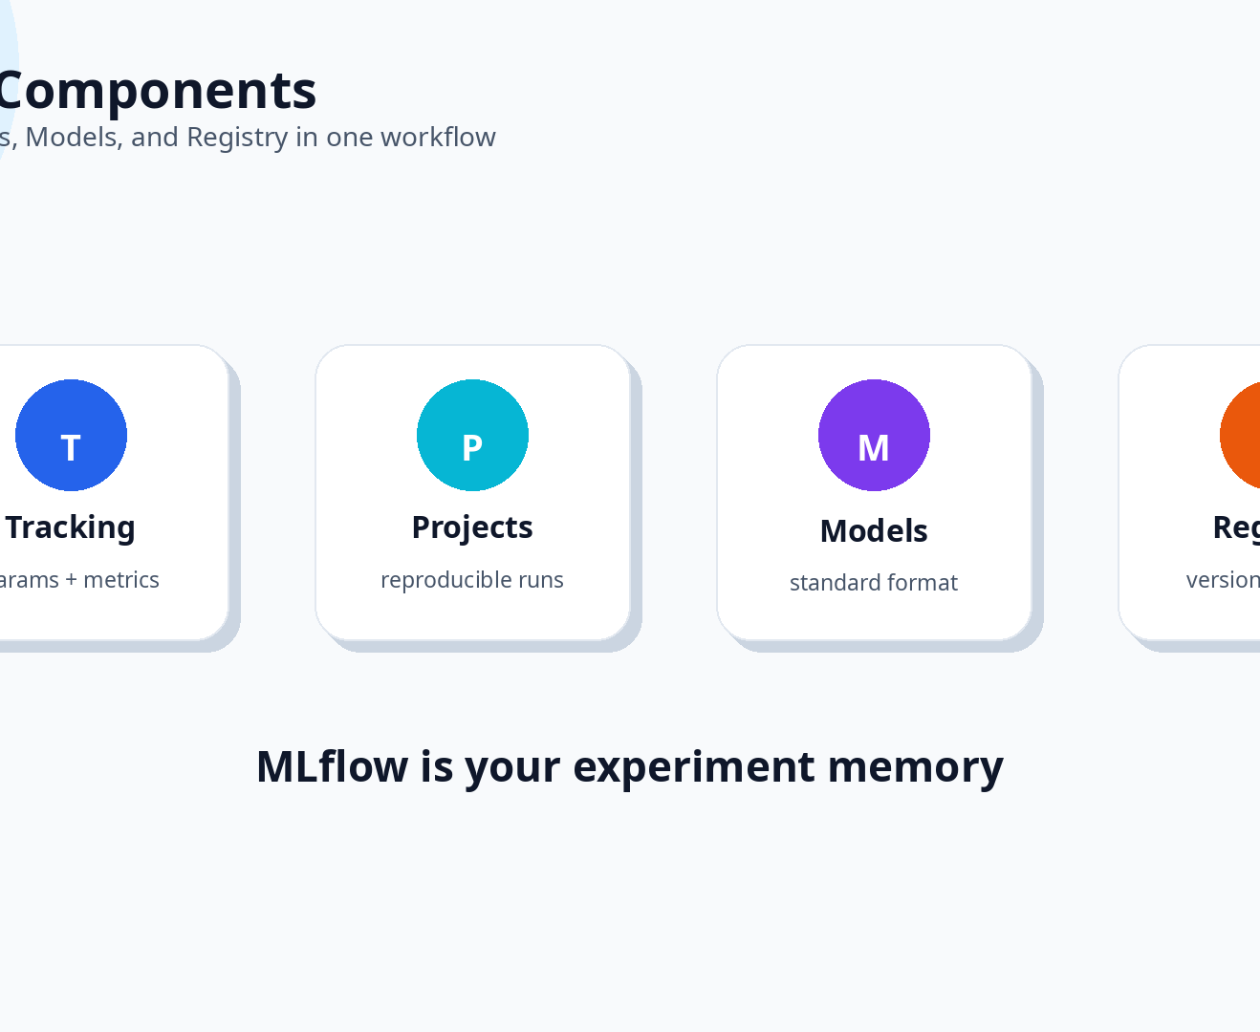
MLflow & Registry
39
MLflow: The Experiment Tracking and Model Management Tool
• MLflow Tracking: record parameters, metrics, code version, and artifacts for each run; compare runs in a UI.
• MLflow Projects: package the training code in a reproducible format: conda or Docker.
• MLflow Models: save the model in a standard deployable format called a flavor.
• MLflow Model Registry: manage model versions, stages, and deployment.

Slide 40
MLflow & Registry
40
Logging a Run with MLflow
Every detail of this run is now stored and queryable.
import mlflow
with mlflow.start_run():
mlflow.log_param("model", "RandomForest")
mlflow.log_param("max_depth", 5)
mlflow.log_metric("f1", f1_score)
mlflow.log_metric("auc", auc)
mlflow.sklearn.log_model(model, "model")
• Parameters, metrics, and artifacts become searchable.
• You can compare runs instead of guessing from file names.
• Six months later, MLflow acts like your external memory.

Slide 41
MLflow & Registry
41
A Logging Checklist
• ✅ Parameters: model type, n_estimators, max_depth, learning_rate, batch_size, data version.
• ✅ Metrics: accuracy, precision, recall, F1, AUC, log loss.
• ✅ Artifacts: trained model file, confusion matrix plot, feature importance chart, dataset snapshot path.
• ✅ Tags: short description of experiment goal, runner, date.
• Why log everything? When you look back six months later, you will have forgotten every detail.
MLflow is your external memory.

Slide 42
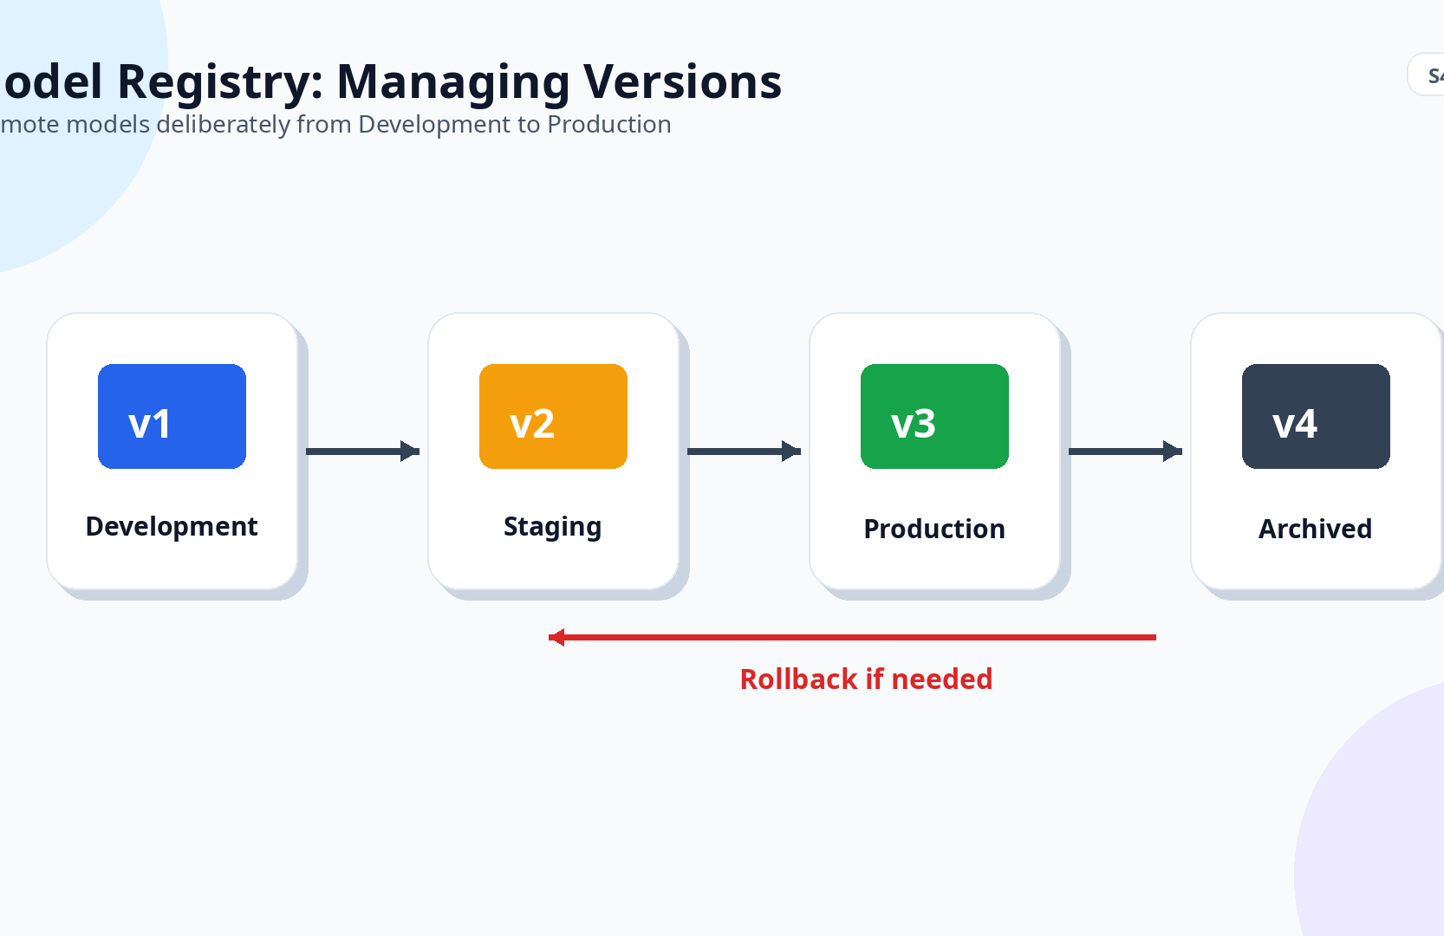
MLflow & Registry
42
Model Registry: Managing Model Versions
The registry stores model versions and assigns each a stage.
Stage | Meaning
Development | The model is actively experimented with; not ready for production use.
Staging | The model is under final validation; shadow testing may be running.
Production | The model is serving real traffic in the live environment.
Archived | The model is old, replaced, or deprecated; kept for audit.
Promotion from one stage to the next should be deliberate, with required checks.

Slide 43
MLflow & Registry
43
How the Registry Helps in Practice
• Clarity: everyone knows exactly which model is in production.
• Rollback: if the new model performs poorly, you can redeploy the previous Production model.
• Auditability: trace which model was active at any point in time.
• Separation of duties: a data scientist can promote to Staging; an ML engineer or automated gate promotes to Production.

Slide 44
MLflow & Registry
44
MLflow Is a Tool, Not a Decision Maker
• MLflow organizes information and makes it searchable.
• It does not tell you which model to deploy.
• The deployment decision still requires:
– Technical analysis: metrics, robustness, latency
– Business context: cost of errors, customer impact, legal constraints
• MLflow is the lab notebook; the scientist still draws the conclusions.

Slide 45
MLflow & Registry
45
Exercise (1 minute)
• Name three distinct types of information MLflow records for each experiment run.
• Expected answers: Parameters, Metrics, Artifacts.
• Additionally, MLflow stores tags and the code version.
• Ask yourself: which of these do you currently document when you train a model in your own projects?
Parameter + metric + artifact = a run you can understand later.

Slide 46
Kubernetes
46
Why Docker Alone Is Not Enough for Production
• Docker runs one container on one machine. Production has bigger problems:
• Crashes: if the API container dies, the service is down until someone restarts it.
• Traffic spikes: a single container may not handle many concurrent loan requests.
• Zero-downtime updates: replacing a model should not interrupt users.
• Multiple replicas and multi-service dependencies need orchestration.
• Kubernetes manages a cluster of machines and orchestrates containers across them.

Slide 47
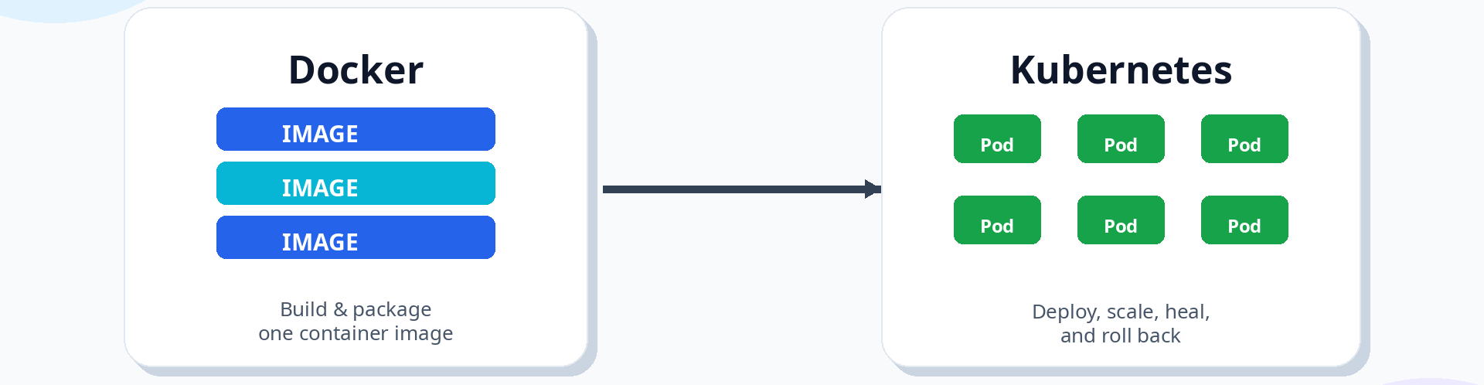
Kubernetes
47
Docker and Kubernetes Are Not Competitors
They are complementary parts of the production stack.
Aspect | Docker | Kubernetes
Role | Packages and runs a single container | Manages many containers across many servers
Focus | One container | Entire cluster of services and replicas
Scaling | Manual | Automatic declarative replicas
Self-healing | None | Restarts failed Pods automatically
Updates | Manual stop-and-start | Rolling updates with zero downtime and rollback

Slide 48
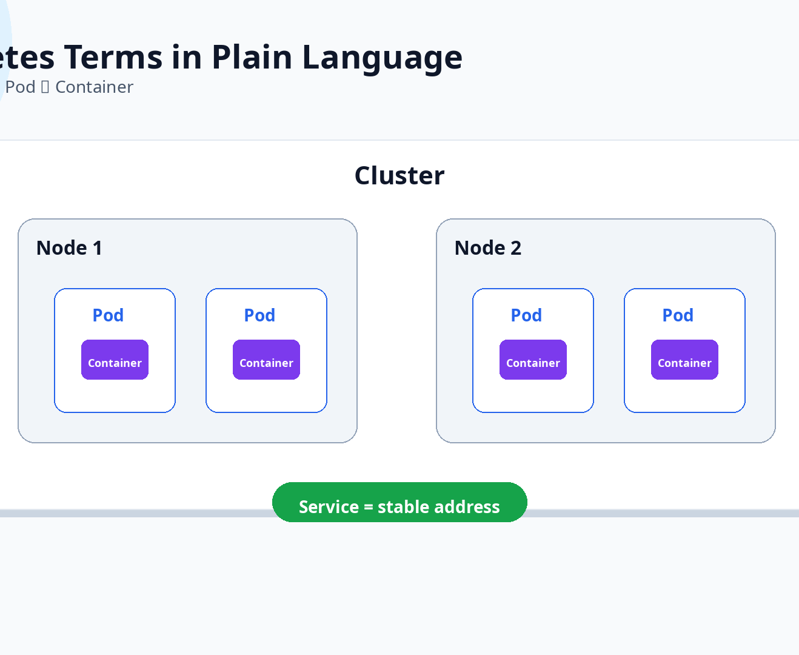
Kubernetes
48
Key Kubernetes Terms in Plain Language
• Cluster: a set of machines controlled by Kubernetes.
• Node: a single physical or virtual machine inside the cluster.
• Pod: the smallest deployable unit, typically containing our API container.
• Deployment: defines replicas, image, and update strategy.
• Service: a stable network address in front of Pods.
• ConfigMap / Secret: store configuration and sensitive values separately from code.

Slide 49
Kubernetes
49
A Kubernetes Deployment Manifest
Keep three instances of loan-model-api:v1 running at all times.
apiVersion: apps/v1
kind: Deployment
metadata:
name: loan-model-api
spec:
replicas: 3
selector:
matchLabels:
app: loan-model-api
template:
metadata:
labels:
app: loan-model-api
spec:
containers:
- name: api
image: loan-model-api:v1
ports:
- containerPort: 8000
• If a Pod crashes, a new one is created automatically.
• To update the model, change the image tag.
• Kubernetes performs a rolling update.

Slide 50
Kubernetes
50
Exposing Pods via a Service
Pods come and go, but the Service address stays stable.
apiVersion: v1
kind: Service
metadata:
name: loan-model-service
spec:
selector:
app: loan-model-api
ports:
- protocol: TCP
port: 80
targetPort: 8000
Client
Service
Pod 1
Pod 2
Pod 3
The Service load-balances requests across healthy Pods.

Slide 51
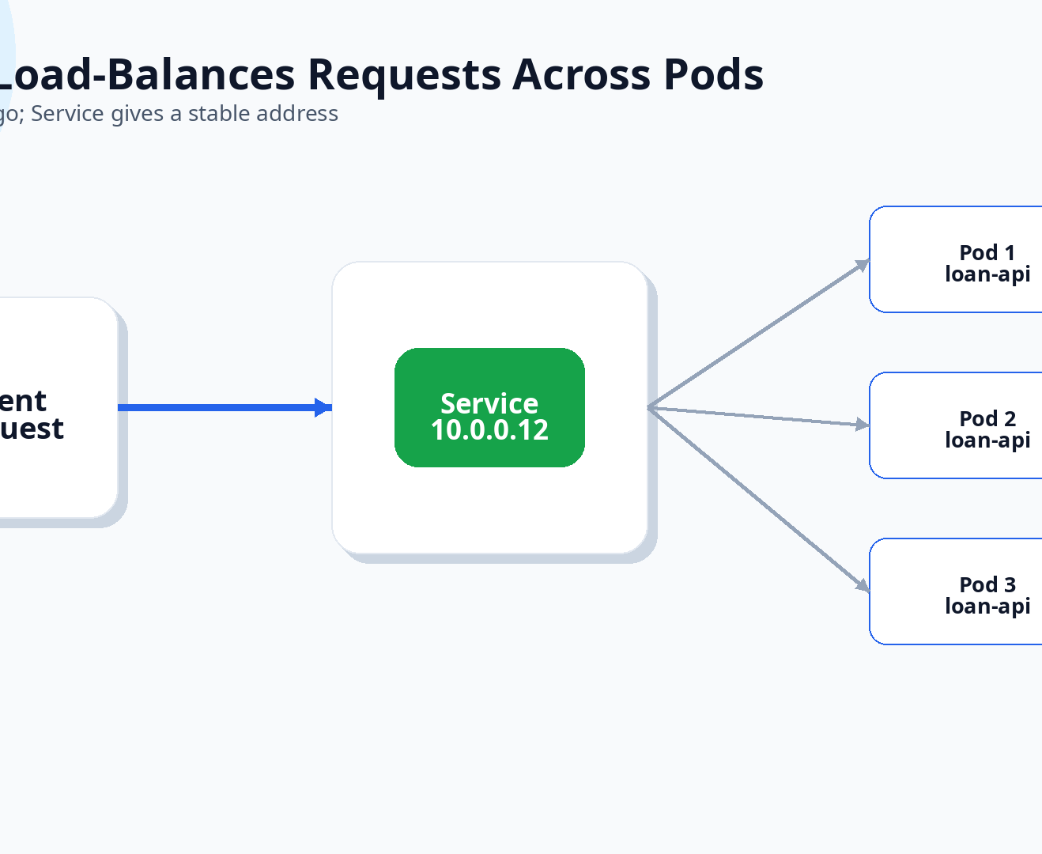
Kubernetes
51
The resulting architecture:
• The Service load-balances requests across the healthy Pods.
• Clients call one stable address.
• Kubernetes routes traffic to available replicas.
• If one Pod dies, traffic continues to the others.

Slide 52
Kubernetes
52
Production-Grade Features That Keep Your Model Healthy
• Self-healing: if a Pod crashes, Kubernetes replaces it automatically.
• Scaling: when traffic increases, Kubernetes can increase the number of Pods.
• Rolling update: new model versions replace old Pods one at a time — no downtime.
• Rollback: if the new model shows errors or worse performance, you can roll back.
• These properties turn a fragile single-container setup into a resilient production system.

Slide 53
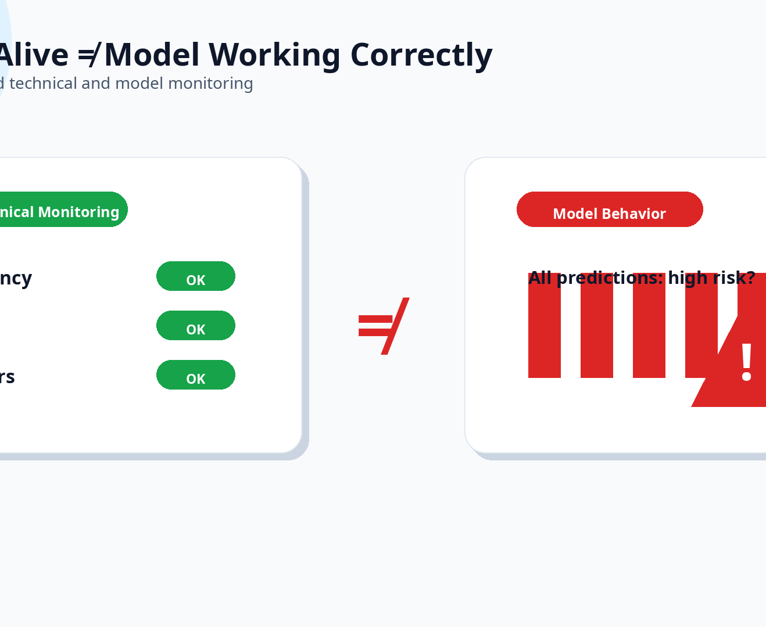
Monitoring, Drift & Retraining
53
Why Standard Monitoring Is Not Enough
• Traditional monitoring checks whether the service is up: latency, error rate, CPU, memory.
• For an ML model, all these can be green and the model can still be broken.
• It might return the same prediction for every input.
• Customer demographics might have shifted.
• The relationship between income and default risk may have changed.
• “Service alive” is not the same as “model working correctly.”

Slide 54
Monitoring, Drift & Retraining
54
Complete Monitoring View for the Loan Model
Each category can silently degrade and must be tracked.
Category | What to Watch | Example Metric
System Metrics | Infrastructure health | Latency, error rate, CPU, memory
Data Quality | Incoming data integrity | Missing values in credit_score, schema changes
Input Distribution | Feature distributions over time | Average applicant age, income distribution
Prediction Distribution | Output behavior | Ratio of high-risk vs low-risk predictions
Performance Metrics | Model quality when labels arrive | Accuracy, F1, precision, recall
Business Metrics | Real-world impact | Default rate, approval rate, complaints

Slide 55
Monitoring, Drift & Retraining
55
Log Every Request for Future Analysis
Prediction logs are the bridge between serving and real evaluation.
request_id | timestamp | features | prediction | probability | model_version
1001 | 2026-05-01 | age=42, income=72k, score=680 | 0 | 0.23 | v3
1002 | 2026-05-01 | age=59, income=41k, score=590 | 1 | 0.81 | v3
1003 | 2026-05-02 | age=35, income=88k, score=720 | 0 | 0.12 | v3
• Store these logs securely and watch out for PII regulations.
• When the ground truth label arrives months later, join it with the log to compute real performance.
• Until then, monitor input and prediction distributions for early drift signals.

Slide 56
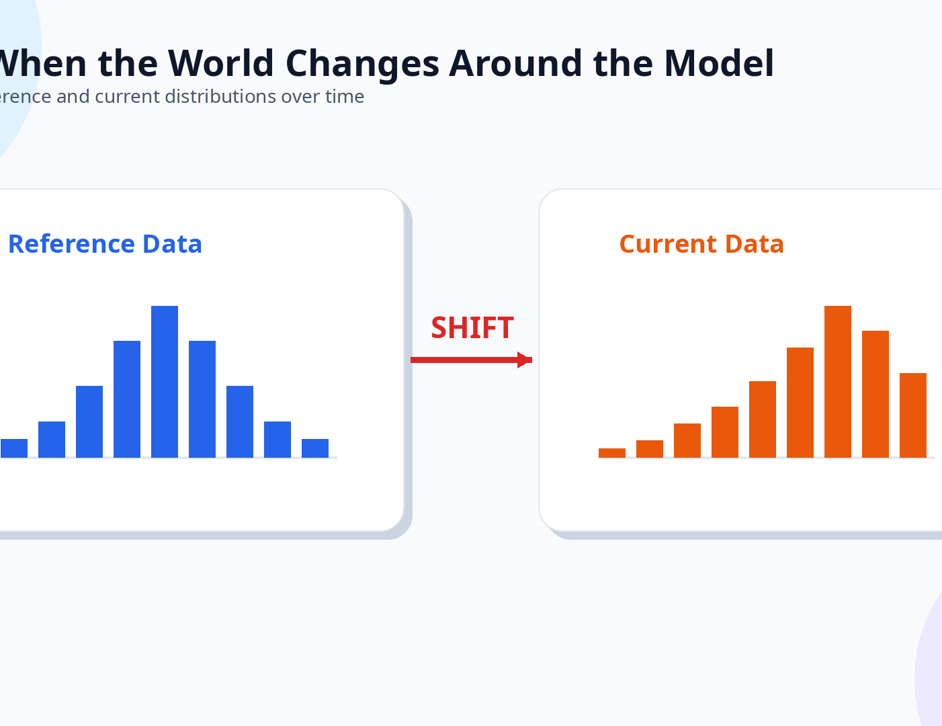
Monitoring, Drift & Retraining
56
Drift: When the World Changes Around Your Model
Compare reference and current distributions over time.
Drift Type | Definition | Loan Model Example
Data Drift | Input feature distribution changes | Average applicant age moves from 35 to 55
Prediction Drift | Model prediction distribution changes | Model flags 80% of applicants as high-risk
Concept Drift | Relationship between inputs and target changes | High income no longer means low risk after a crash
Label Drift | Actual outcome distribution shifts | Default rate increases due to recession
Performance Degradation | Model metrics drop | F1 falls from 0.84 to 0.68

Slide 57
Monitoring, Drift & Retraining
57
How to Detect Drift Without Complex Tools
• Compare Reference Data, such as training data or a stable production window, with Current Data.
• For numerical features:
– Compare mean, median, and standard deviation
– Plot reference vs current histograms
– Use statistical tests like the Kolmogorov-Smirnov test
• For categorical features:
– Compare frequency distributions
– Use chi-squared test
• Industry metric: Population Stability Index (PSI) for a single score.
• Goal: raise a flag when incoming data looks significantly different from training data.

Slide 58
Monitoring, Drift & Retraining
58
Drift Does Not Automatically Mean “Retrain Now”
• Some drift is natural and expected: holiday shopping behavior or seasonal loan applicants.
• What matters is the impact of drift.
• Has model performance actually degraded?
• Are predictions causing business harm?
• Is the incoming data valid, or is there a broken data pipeline?
• Common mistake: seeing drift and immediately deploying a retrained model.
• First investigate data quality, feature pipeline, and performance on recent labeled data.
Drift is a signal to investigate, not an automatic deploy button.

Slide 59
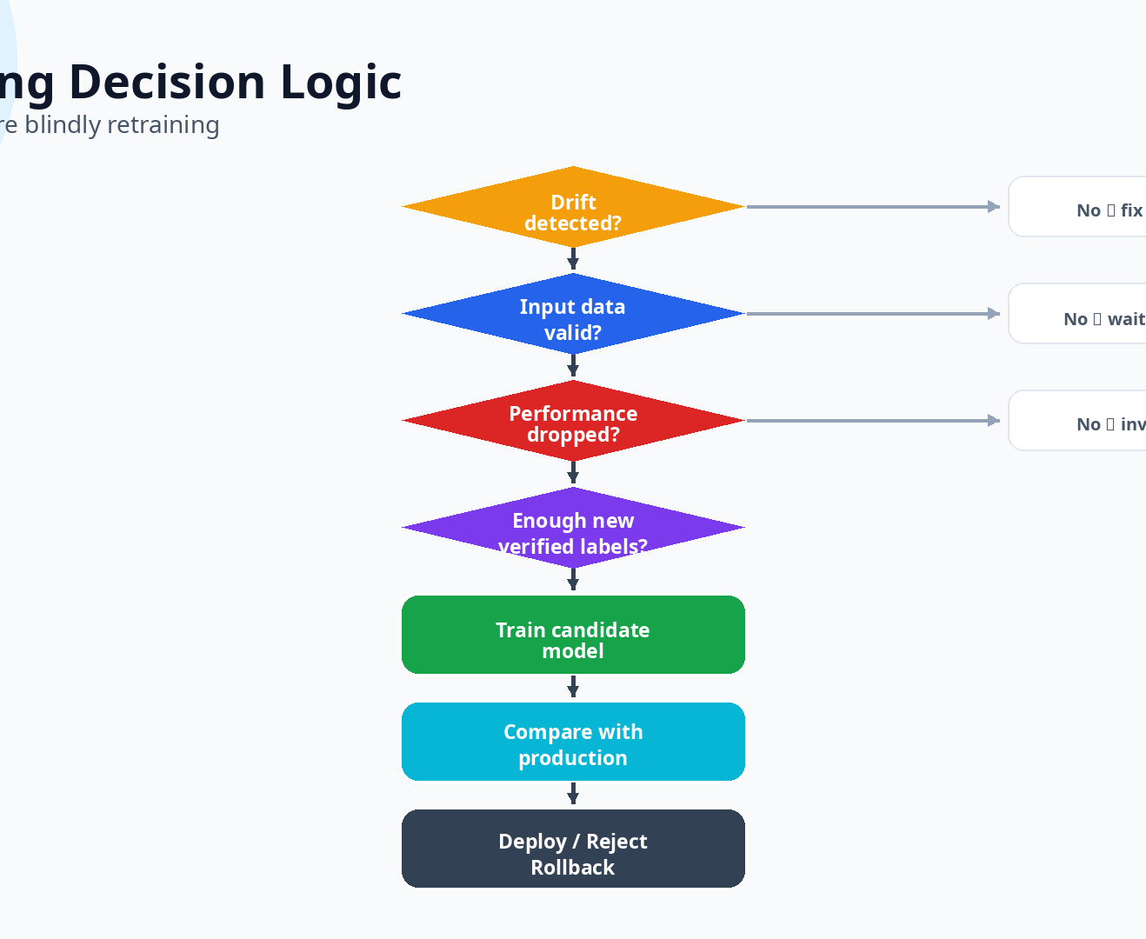
Monitoring, Drift & Retraining
59
Retraining Decision Logic
• Drift detected?
• Is the input data valid: no broken pipeline or missing values flooding?
• Has model performance actually dropped on recent labeled data?
• Do we have enough new, verified labels?
• Train a candidate model.
• Compare candidate with current production model: metrics, fairness, latency.
• Deploy, reject, investigate further, or rollback.
If any answer is No, address that problem first — do not blindly retrain.

Slide 60
Monitoring, Drift & Retraining
60
Four Approaches to Retraining, from Simple to Advanced
Choose a strategy based on risk, monitoring maturity, and team capacity.
Strategy | How It Works | Advantage | Risk
Manual | Human decides to train and deploy | Full control | Slow, may miss degradation
Scheduled | Retrain on a calendar, e.g., monthly | Regular, predictable | May retrain when not needed, or too late
Trigger-based | Retrain when drift or performance drop exceeds threshold | Reactive to real change | Requires good monitoring and thresholds
Continuous Training | Fully automated pipeline: data → train → test → deploy | Fast adaptation, scalable | Complex, risk of bad deployments
For an undergraduate-level system, manual or scheduled retraining is a good starting point.

Slide 61
Monitoring, Drift & Retraining
61
Before Deploying a New Model, Verify:
• ✅ It performs better on the new test set.
• ✅ It does not regress severely on the old test set.
• ✅ Important metrics beyond accuracy are checked, especially recall for high-risk class.
• ✅ Latency is acceptable.
• ✅ It behaves fairly across different user groups.
• ✅ Rollback is possible.
• ✅ Model version, data version, and code are recorded in MLflow.

Slide 62
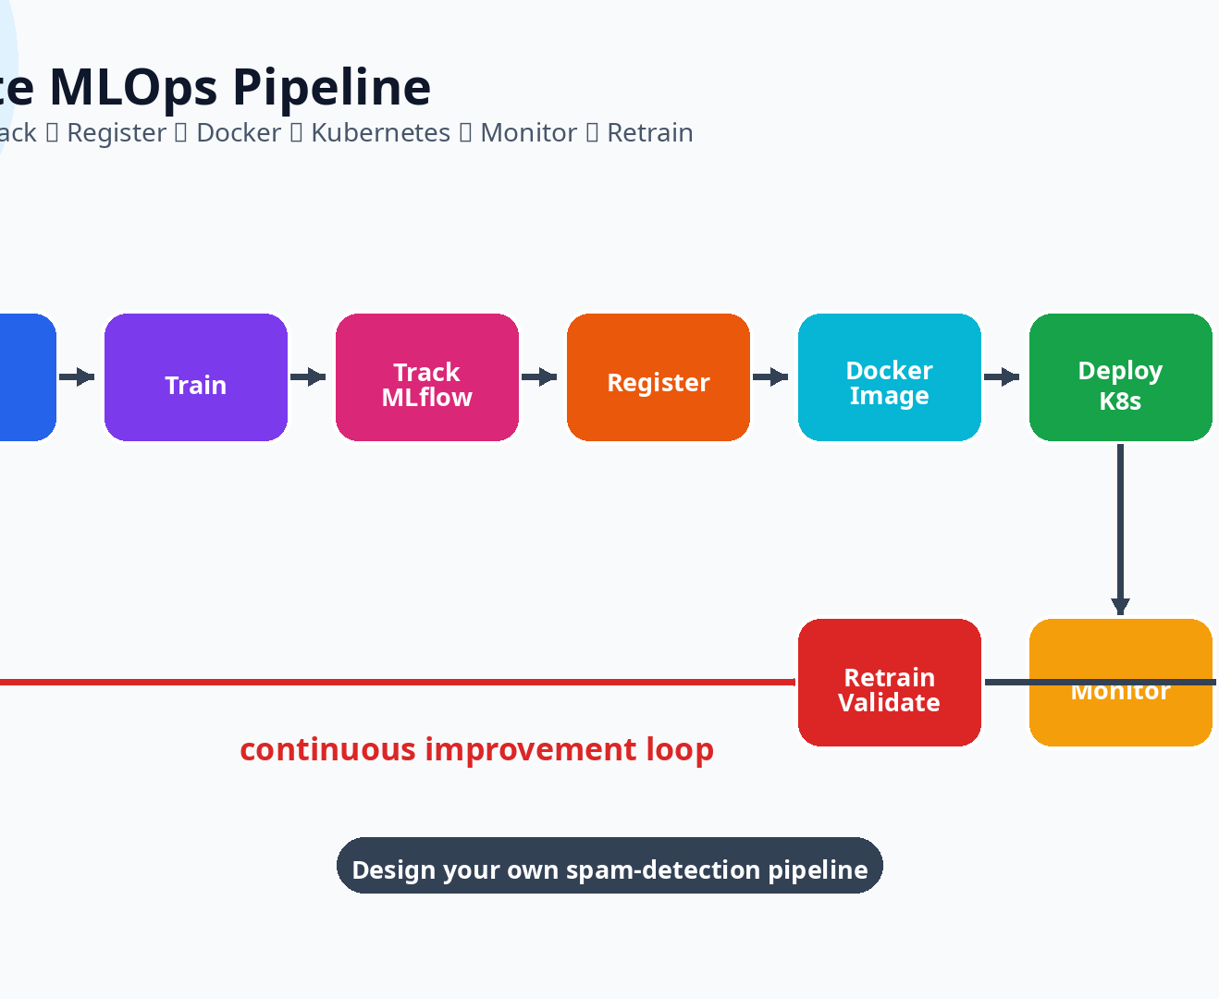
Monitoring, Drift & Retraining
62
The Complete MLOps Pipeline:
• Data → Train → Track (MLflow) → Register → Docker Image → Deploy (Kubernetes) → Monitor (System, Data, Drift) → Retrain / Validate / Rollback
• Class Exercise (2 minutes): in groups, design a spam-detection MLOps pipeline.
• Name the components you need: data, train script, MLflow, Docker API, Kubernetes deployment, monitoring, retraining.
Design your own spam-detection pipeline.

Slide 63
Monitoring, Drift & Retraining
63
End-of-Class Questions:
• What is the difference between Docker and Kubernetes?
• Why is MLflow useful for ML projects?
• What is the difference between Data Drift and Concept Drift?
• Why shouldn’t you retrain the model immediately at the first sign of drift?
• For a loan model, which metrics are more important than accuracy?

